Slide 1
3 Axis Pin Development Update
Week #10

Slide 2
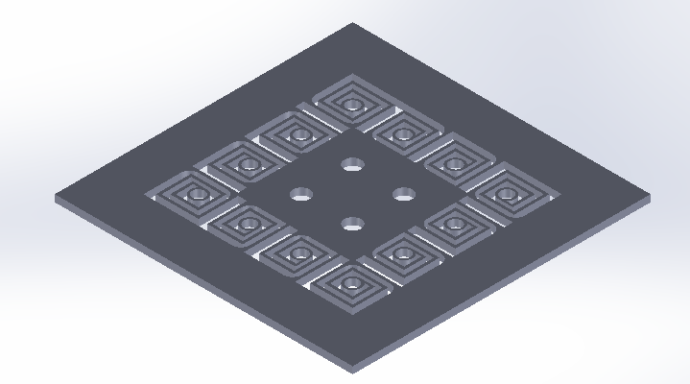
Swirly Pivot Mount

Slide 3

Attempted solution to ‘slots’ idea
Allows for independent but constrained motion of pins
Relative motion is controlled by pulley system
Requires impedance of swirl springs to be greater than that of the skin
Issue: Too much compliance in the horizontal plane

Slide 4
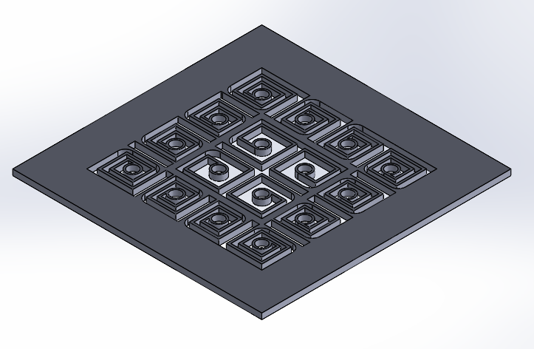
Swirly Pivot Mount V2

Slide 5
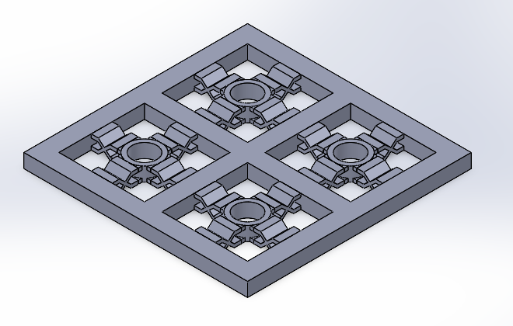
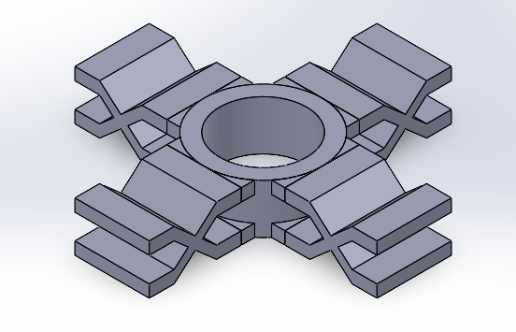
Scissor Pivot Mount

Slide 6
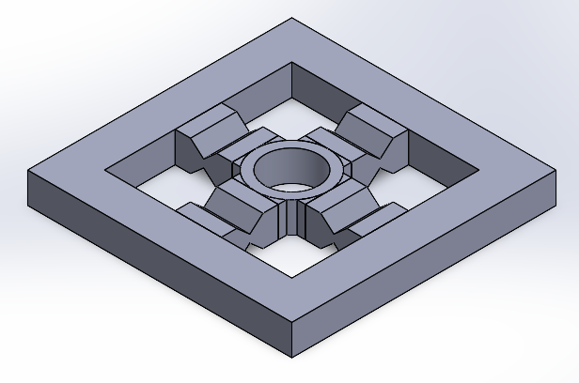
Better (slightly) Scissor Pivot Mount

Slide 7
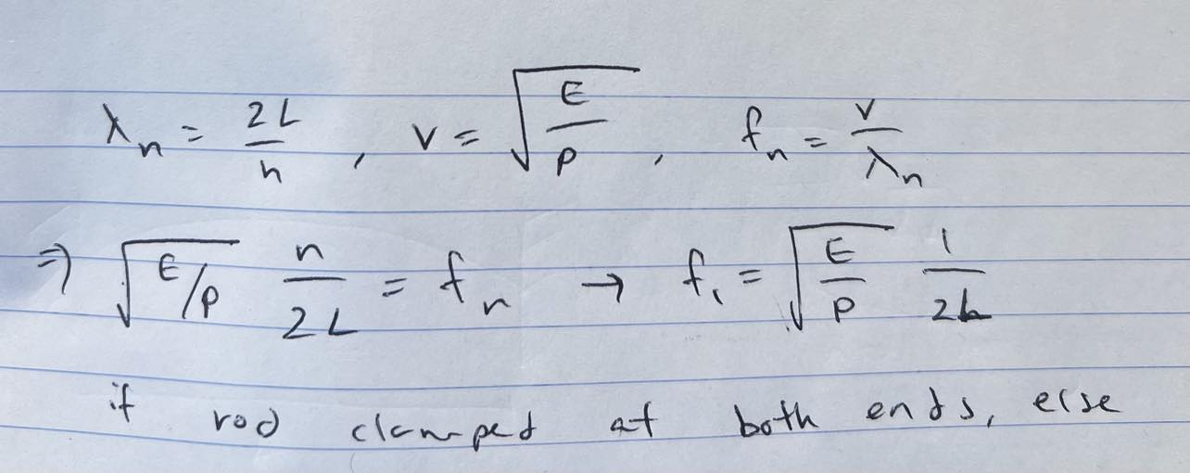
1st Normal Mode Frequency (Clamped at both ends)
As long as length < 63.19 cm, f > 300 Hz

Slide 8
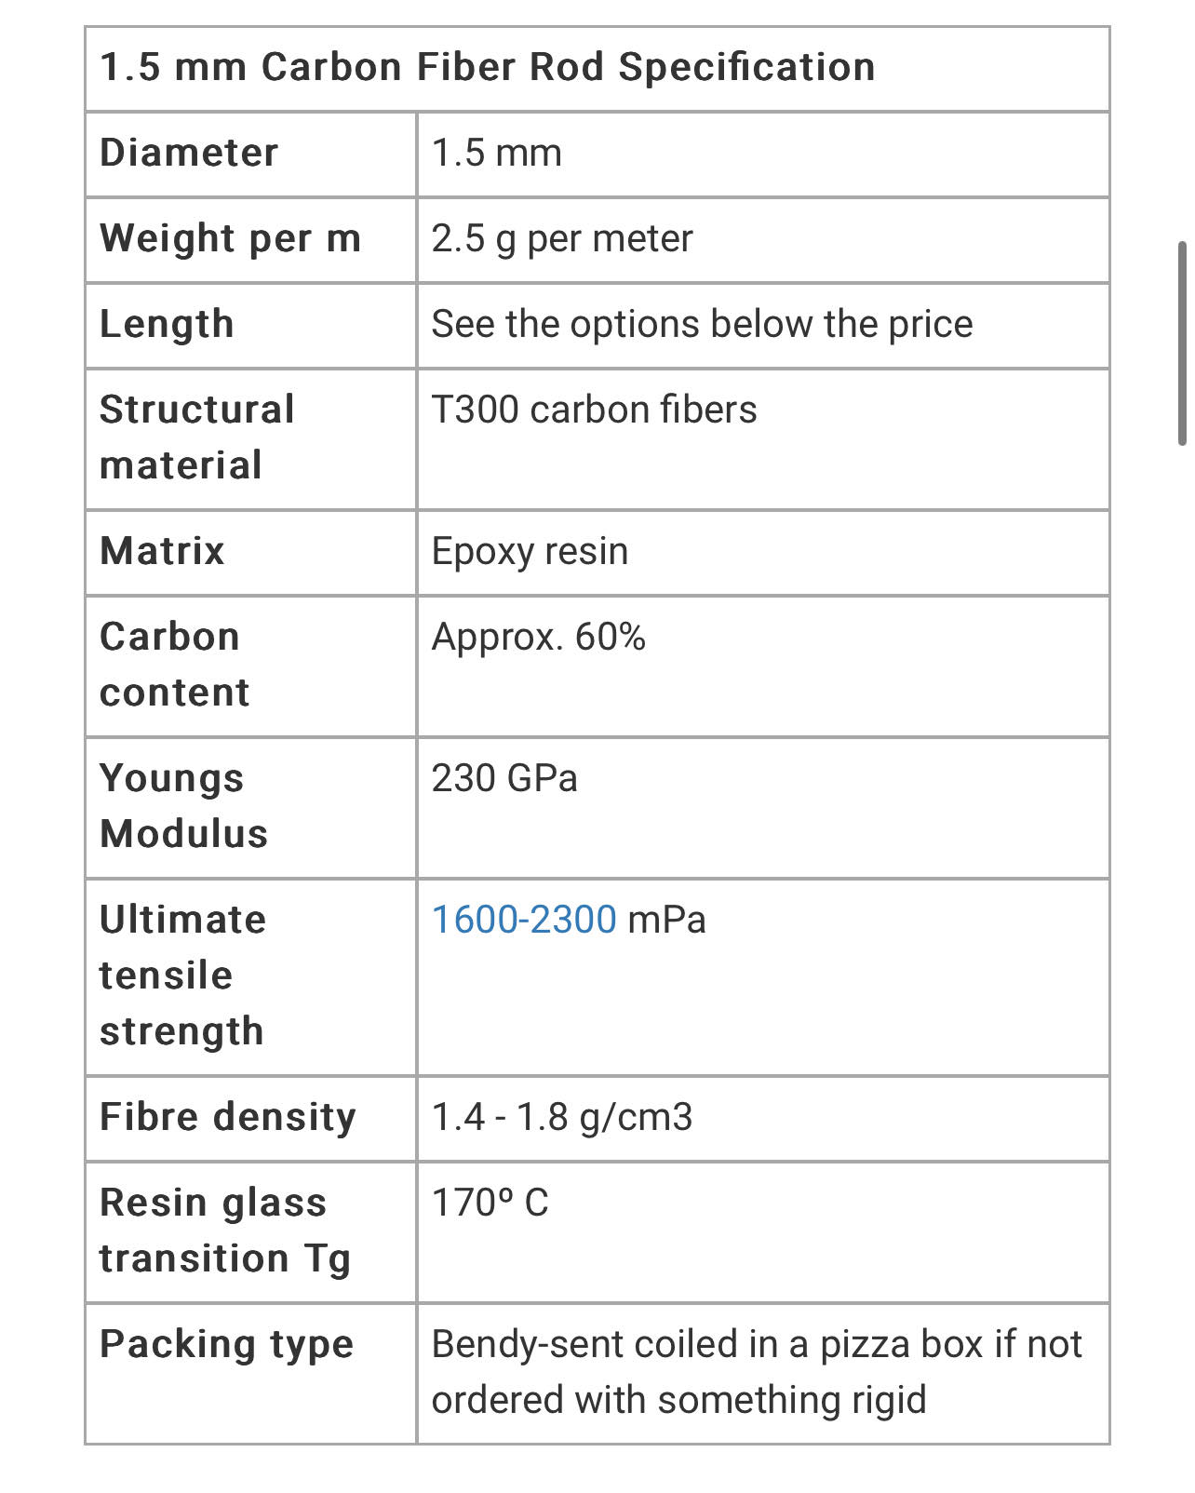
Rod Parameters
https://www.hyperflight.co.uk/products.asp?code=CARBON-ROD-15MM&name=1-5mm-carbon-rod&fbclid=IwAR38WoZ2lWlQhBS_eNL4IRFo6Wo-6U4sWvSkZ6Svug4WLcLmZKkoAdgomUQ

Slide 9
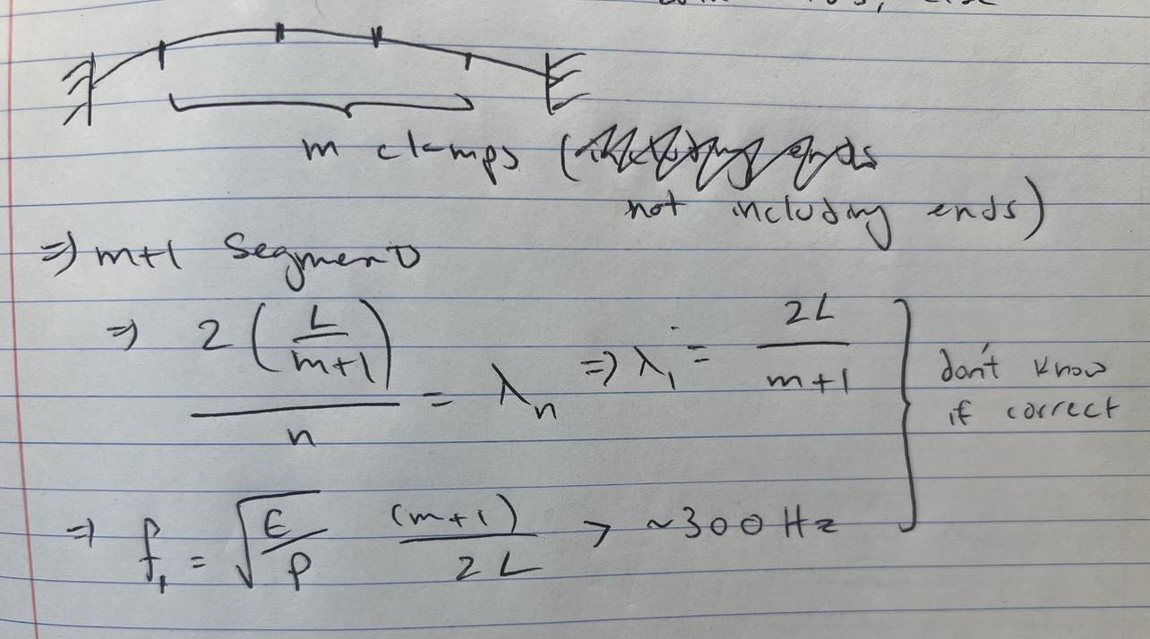
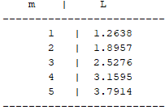
1st Normal Mode Frequency (with m clamps in between, including 2 outer clamps)

Slide 10
Inconsistencies
Answer of two clamped ends (L < 63 cm) does not match with previous results
Errors could be the equations themself
Parameters of Rod

